Slide 1
PERSIAN GULF
VFR
DEPARTURE AND RECOVERY ROUTES

Slide 2
AL DAHFRA VFR DEPARTURE ROUTES
AL GURM
6000
For reciprocal departures (e.g. MANSA-1 from 13L), do not turn before the end of the runway after take-off
DO NOT OVERFLY THE AIRFIELD!
MANSA-1
EYEBALL
6000
336˚
MANSA-2
286˚
2000
6000
268˚
HEXX
HARBOUR
6000
MANSA-3
308˚
1500
207˚
OMAM
6000
X-JUNCTION
LAKE
LUGAL-2
1500
128˚
2000
058˚
LUGAL-1
6000
RACETRACK
096˚
6000
HIGHWAY
VILLAGE
MANSA-4 / LUGAL-4
LUGAL-3
MANSA-1
Fly 308˚ to 2000’ by 6nm, then climb 336˚ to be at or above 6000’ at AL GURM
LUGAL-1
Fly 128˚ to 2000’ by 6nm, then climb 058˚ to be at or above 6000’ at LAKE. Continue own navigation from LAKE
MANSA-2
Fly 308˚ to 2000’ by 6nm, then climb 286˚ to be at or above 6000’ at EYEBALL
LUGAL-2
Fly 128˚ to 2000’ by 6nm, then climb 058˚ to be at or above 6000’ at LAKE. Continue at or above 6000’ to X-JUNCTION
MANSA-3
Fly 308˚ to 2000’ by 6nm, then climb 268˚ to be at or above 6000’ at HEXX
LUGAL-3
Fly 128˚ to 2000’ by 6nm, then climb 096˚ to be at or above 6000’ at VILLAGE
MANSA-4
Fly 308° to 2000’ by 6 nm, then climb 252˚ to be at or above 6000’ at HIGHWAY
LUGAL-4
Downwind turn after departure to be at 1500’ until clear of the pattern. Continue as with MANSA-4

Slide 3
AL DAHFRA VFR RECOVERY ROUTES
AL GURM
5000
3000
MALIK-1
Enter Downwind normal traffic pattern when performing a reciprocal approach (e.g. MALIK-1 arrival for 31L)
5000
3000
EYEBALL
156˚
MALIK-2
5000
3000
100˚
1500
088˚
5000
3000
HEXX
HARBOUR
128˚
OMAM
MALIK-3
5000
3000
207˚
X-JUNCTION
LAKE
LAMANE-2
308˚
1500
238˚
LAMANE-1
5000
3000
276˚
5000
3000
RACETRACK
VILLAGE
HIGHWAY
LAMANE-3
MALIK-4 / LAMANE-4
MALIK-1
Enter AL GURM between 5000ft and 3000ft, descend to 1500ft at HARBOUR.
Then Straight-in or Overhead break
LAMANE-1
Enter LAKE between 5000ft and 3000ft, descend to 1500ft at RACETRACK.
Then Straight-in or Overhead break
MALIK-2
Enter EYEBALL between 5000ft and 3000ft, descend to 1500ft at HARBOUR.
Then Straight-in or Overhead break
LAMANE-2
Enter X-JUNCTION between 5000ft and 3000ft,cross LAKE between 5000ft and 3000ft descend to 1500ft at RACETRACK.
Then Straight-in or Overhead break
MALIK-3
Enter HEXX between 5000ft and 3000ft, descend to 1500ft at HARBOUR.
Then Straight-in or Overhead break
LAMANE-3
Enter VILLAGE between 5000ft and 3000ft, descend to 1500ft at RACETRACK.
Then Straight-in or Overhead break
MALIK-4
Enter HIGHWAY between 5000ft and 3000ft, descend to 1500ft at HARBOUR.
Then Straight-in or Overhead break
LAMANE-4
Enter HIGHWAY between 5000ft and 3000ft, descend to 1500ft at HARBOUR.
Join DOWNWIND pattern for active RWY

Slide 4
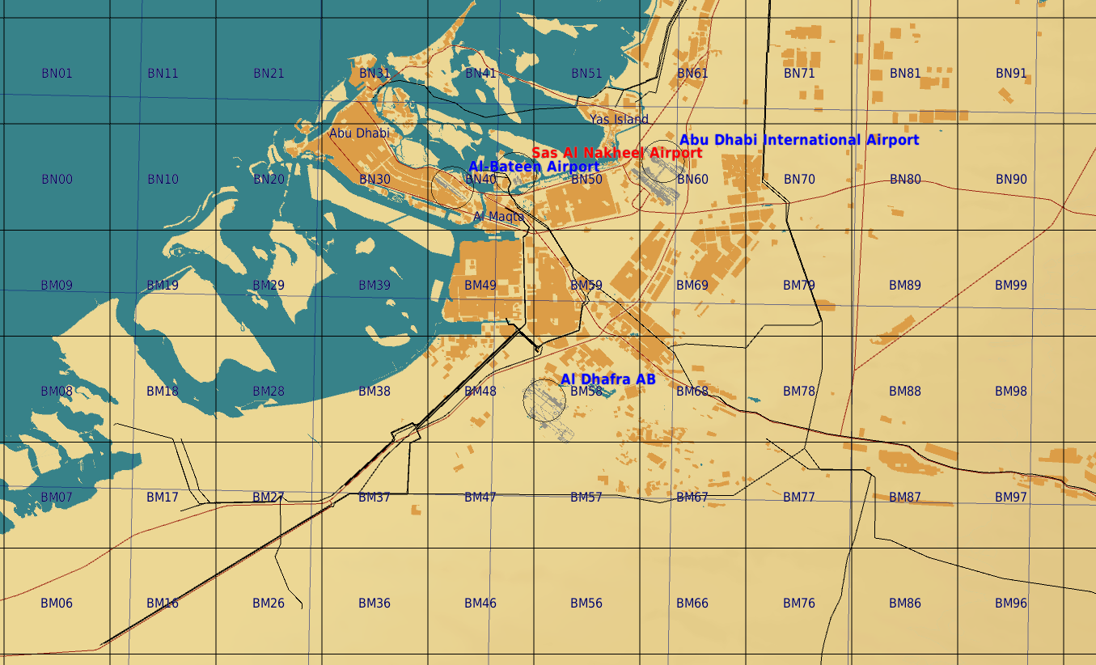
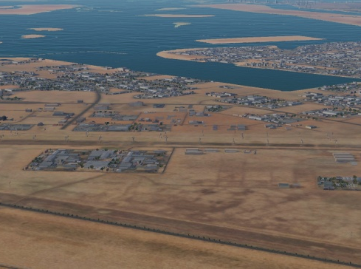
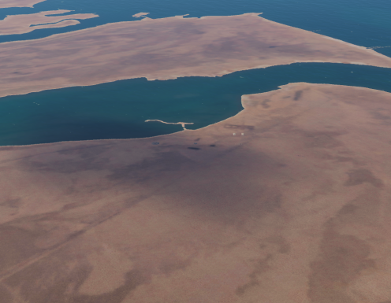
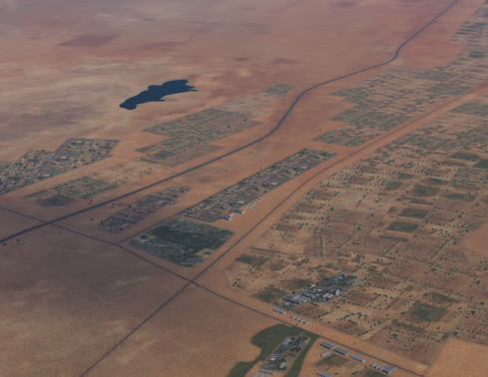
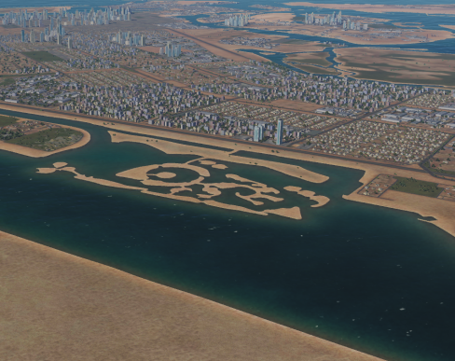
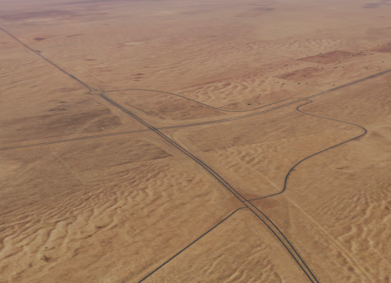
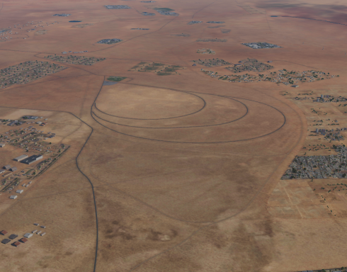
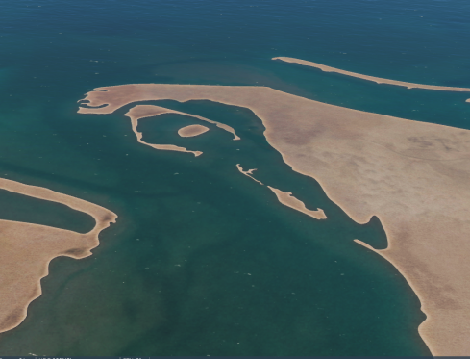
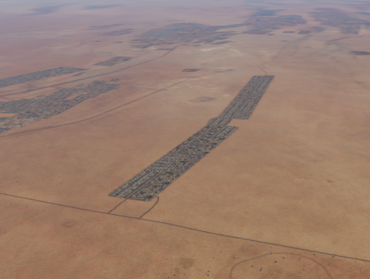
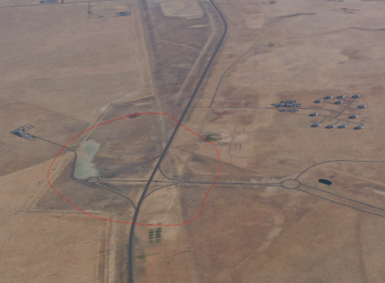
Al Gurm
Eyeball
Harbour
Lake
X-Ray junction
Hexx
Highway
Racetrack
Village
Harbour
Hexx
Lake
Al Gurm
X-Ray junction
Racetrack
Eyeball
Village
Highway

Slide 5
AL AIN VFR DEPARTURE ROUTES
6000
Village
073˚
113˚
6000
4500
Circles
T-junction
002˚
OMAL
185˚
3300
048˚
Field
120˚
5000
Roads
RWY 01 (VILLAGE)
Fly 002˚ to 4500’ by 9.7nm, then climb 073˚ to be at or above 6000’ at VILLAGE.
RWY 19 (ROADS)
Fly 185˚ to 3300’ by 6.5nm, then climb 120˚ to be at or above 6000’ at ROADS.
RWY 01 (CIRCLES)
Fly 002˚ to 4500’ by 9.7nm, then climb 113˚ to be at or above 6000’ at CIRCLES.
RWY 19 (CIRCLES)
Fly 185˚ to 3300’ by 6.5nm, then climb 048˚ to be at or above 6000’ at CIRCLES.

Slide 6
AL AIN VFR RECOVERY ROUTES
4000
5000
Village
253˚
294˚
4000
5000
3500
Circles
T-junction
182˚
OMAL
006˚
OVERHEAD RWY 01 (CIRCLES)
Intercept CIRCLES between 4000’ and 5000’ outbound 228˚ , right turn to 006˚ at FIELD leveling out at 2300’ for a LEFT BREAK.
2300
228˚
Field
300˚
3000
4000
OVERHEAD RWY 01 (ROADS)
Intercept ROADS between 3000’ and 4000’ outbound 300˚ , right turn to 006˚ at FIELD leveling out at 2300’ for a LEFT BREAK.
Roads
OVERHEAD RWY 19 (CIRCLES)
Intercept CIRCLES between 4000’ and 5000’ outbound 294˚ , left turn to 182˚ at T-JUNCTION below 3500’, descend to 2300’ for a RIGHT BREAK.
STRAIGHT IN RWY 01
From FIELD, follow glideslope.
OVERHEAD RWY 19 (VILLAGE)
Intercept VILLAGE between 4000’ and 5000’ outbound 253˚ , left turn to 182˚ at T-JUNCTION below 3500’, descend to 2300’ for a RIGHT BREAK.
STRAIGHT IN RWY 19
From T-JUNCTION, follow glideslope.

Slide 7
AL AIN VFR DEPARTURE ROUTES
6000
Village
073˚
113˚
6000
4500
Circles
T-junction
002˚
OMAL
185˚
3300
048˚
Field
120˚
5000
Roads
RWY 01 (VILLAGE)
Fly 002˚ to 4500’ by 9.7nm, then climb 073˚ to be at or above 6000’ at VILLAGE.
RWY 19 (ROADS)
Fly 185˚ to 3300’ by 6.5nm, then climb 120˚ to be at or above 6000’ at ROADS.
RWY 01 (CIRCLES)
Fly 002˚ to 4500’ by 9.7nm, then climb 113˚ to be at or above 6000’ at CIRCLES.
RWY 19 (CIRCLES)
Fly 185˚ to 3300’ by 6.5nm, then climb 048˚ to be at or above 6000’ at CIRCLES.

Slide 8
AL AIN VFR RECOVERY ROUTES
4000
5000
Village
253˚
294˚
4000
5000
3500
Circles
T-junction
182˚
OMAL
006˚
OVERHEAD RWY 01 (CIRCLES)
Intercept CIRCLES between 4000’ and 5000’ outbound 228˚ , right turn to 006˚ at FIELD leveling out at 2300’ for a LEFT BREAK.
2300
228˚
Field
300˚
3000
4000
OVERHEAD RWY 01 (ROADS)
Intercept ROADS between 3000’ and 4000’ outbound 300˚ , right turn to 006˚ at FIELD leveling out at 2300’ for a LEFT BREAK.
Roads
OVERHEAD RWY 19 (CIRCLES)
Intercept CIRCLES between 4000’ and 5000’ outbound 294˚ , left turn to 182˚ at T-JUNCTION below 3500’, descend to 2300’ for a RIGHT BREAK.
STRAIGHT IN RWY 01
From FIELD, follow glideslope.
OVERHEAD RWY 19 (VILLAGE)
Intercept VILLAGE between 4000’ and 5000’ outbound 253˚ , left turn to 182˚ at T-JUNCTION below 3500’, descend to 2300’ for a RIGHT BREAK.
STRAIGHT IN RWY 19
From T-JUNCTION, follow glideslope.

Slide 9
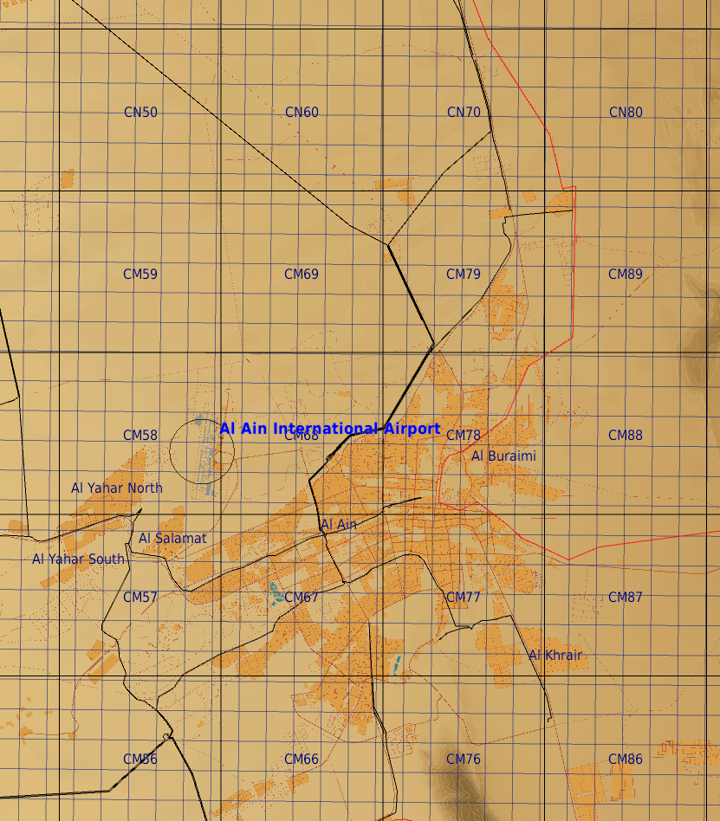
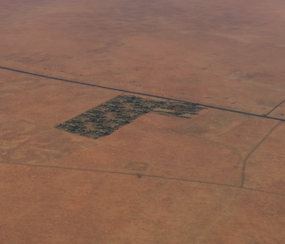
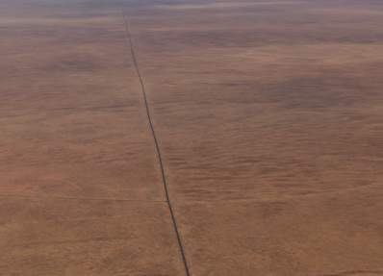
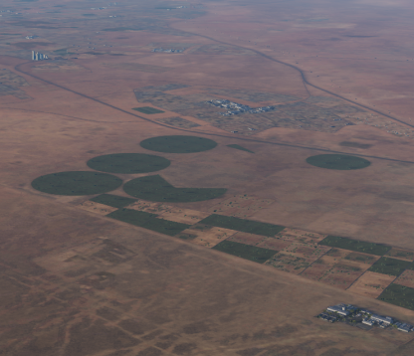
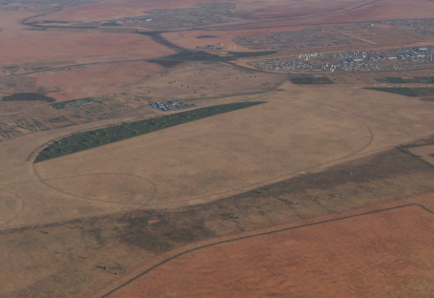
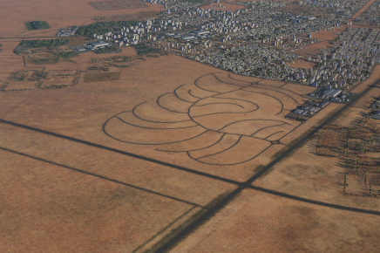
Village
T-junction
Circles
Field
Roads

Slide 10
AL DAHFRA VFR DEPARTURE ROUTES
Al Gurm
6000
Eyeball
6000
336˚
6000
286˚
1500
268˚
Hexx
Harbor
308˚
OMAM
6000
6000
X-Junction
128˚
Lake
1500
058˚
Racetrack
096˚
6000
Village
RWY 31R (MANSA-1)
Fly 308˚ to 1500’ by 6nm, then climb 336˚ to be at or above 6000’ at Al Gurm.
RWY 13L (LUGAL-1)
Fly 128˚ to 1500’ by 6nm, then climb 058˚ to be at or above 6000’ at Lake. Continue own navigation from Lake.
RWY 31R (MANSA-2)
Fly 308˚ to 1500’ by 6nm, then climb 286˚ to be at or above 6000’ at Eyeball.
RWY 13L (LUGAL-2)
Fly 128˚ to 1500’ by 6nm, then climb 096˚ to be at or above 6000’ at Village. Continue at or above 6000’ to X-junction.
RWY 31R (MANSA-3)
Fly 308˚ to 1500’ by 6nm, then climb 268˚ to be at or above 6000’ at Hexx.
RWY 13L (LUGAL-3)
Fly 128˚ to 1500’ by 6nm, then climb 096˚ to be at or above 6000’ at Village.

